Slide 1
Growing
Key Accounts

Slide 2










The last 20 years….

Slide 3
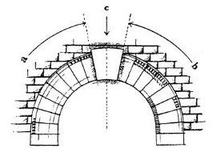
How do you determine who are key accounts?
Share of Account List
Account Value Grid
Current and Potential Investment Levels
Market Share reports
Segment History
Competitive Reports
Problem Seeking

Slide 4
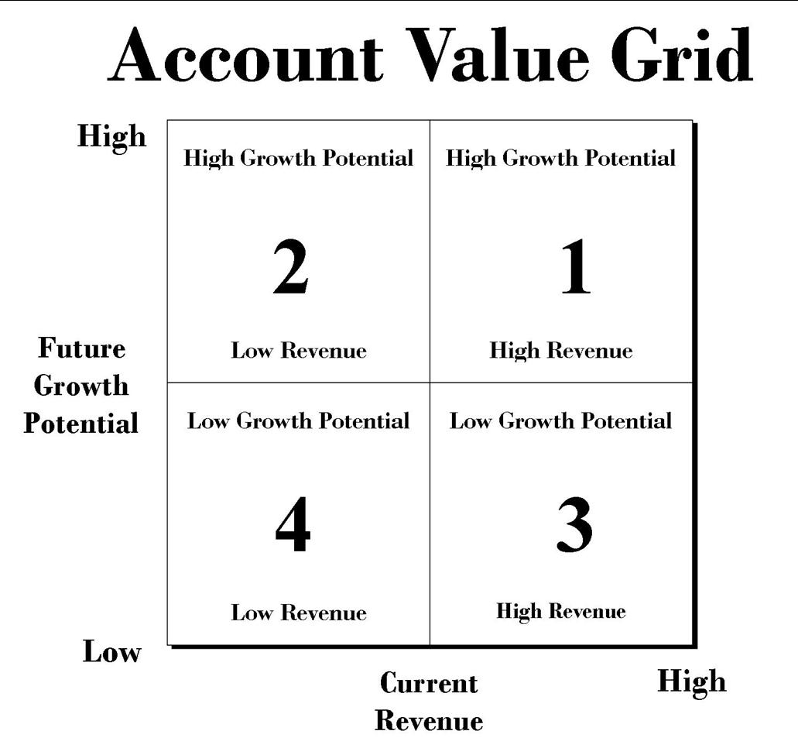
Best opportunities
Not easy, but worth it!
Retain, maintain and keep fresh.
Stop contact.

Slide 5
The Old Way
Pre-call
Planning
Time Spent
Relating
Order
Pitching
Closing

Slide 6
Solution Selling
Pre-call Planning
Time Spent
Need Finding
Ideate
Order
Proposal
Close

Slide 7
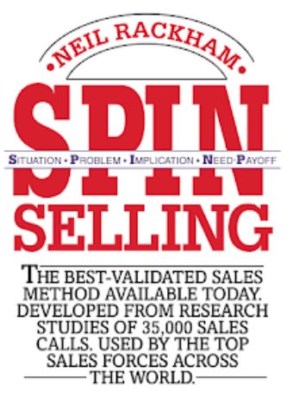
Need Finding
10 Second Summary
Customers will only be motivated to buy something if they identify there’s a need. And because there are times when prospects are not even aware there’s a problem, the questions you ask are key. This book describes a powerful process that reveals four types of questions that when asked in sequence, will significantly increase the likelihood of a lead translating into a sale.

Slide 8
Small Sales and Major Sales are Dramatically Different
Small Sales
Risks of mistakes are lower
Decision is faster (often just one call)
Small sales focus on relating to the customer
Simple features and benefits help close small sales
Objection handling post presentation is common
Major Sales
Risks are higher
Decisions are slower
Relationship is important, but are defined differently
Needs based approach requires deep questioning
Tie benefits to Explicit needs
Prevent objections up front

Slide 9

S.P.I.N. Selling
Situational Questions: Facts, information and background data. (Tip – ask yourself “who benefits from a Situational question?”)
Stuff you should probably already know. Easy loses interest early.

Slide 10
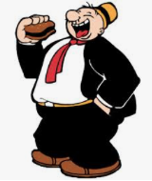
S.P.I.N. Selling
Problem Questions: The purpose of problem questions are to uncover Implied Needs.
Implied Need
Statements made by the customer of problems, difficulties and dissatisfaction
Stopping here = Wimpy Sales

Slide 11

S.P.I.N. Selling
Implication Questions: Questions that uncover the effects, consequences or implications of the customer’s problems. Converts Implied need into Explicit Need.
Explicit Need
The Customer says “I want” or ”I need”
MAKE THEM SAY SAY IT.

Slide 12

S.P.I.N. Selling
Needs/Payoff Questions: These questions focus attention on the solution rather than the problem and they get the customer telling you the benefits.
Turns Continuations
into
Advancements

Slide 13
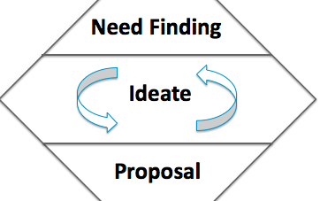
Major Accounts want this the most…

Slide 14
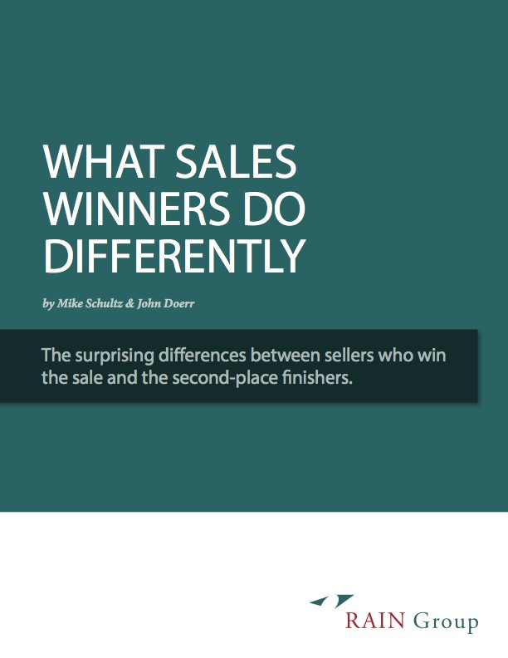
Get the whitepaper:
https://info.rainsalestraining.com/free-report-what-sales-winners-do-differently

Slide 15
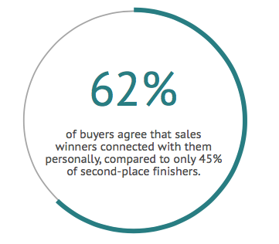
What Sales Winners Do Differently
Get the whitepaper:
https://info.rainsalestraining.com/free-report-what-sales-winners-do-differently

Slide 16
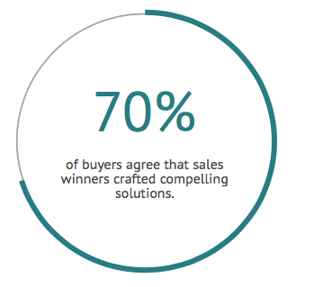
What Sales Winners Do Differently
Get the whitepaper:
https://info.rainsalestraining.com/free-report-what-sales-winners-do-differently

Slide 17
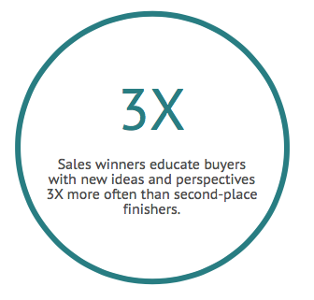
What Sales Winners Do Differently
Get the whitepaper:
https://info.rainsalestraining.com/free-report-what-sales-winners-do-differently

Slide 18
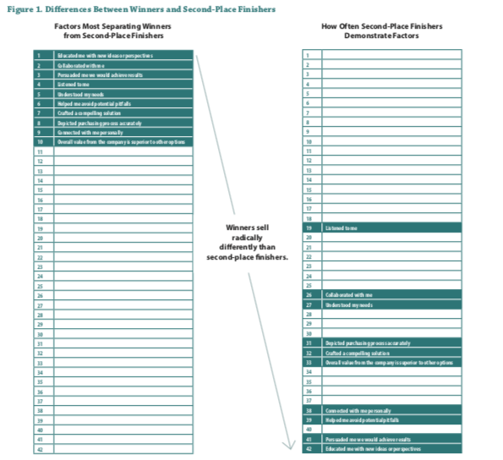
Get the whitepaper:
https://info.rainsalestraining.com/free-report-what-sales-winners-do-differently

Slide 19
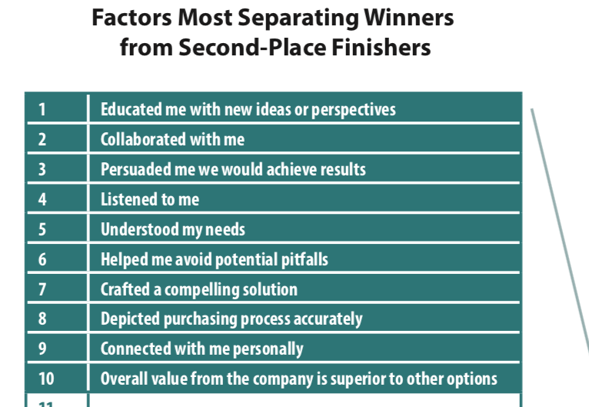
Get the whitepaper:
https://info.rainsalestraining.com/free-report-what-sales-winners-do-differently

Slide 20
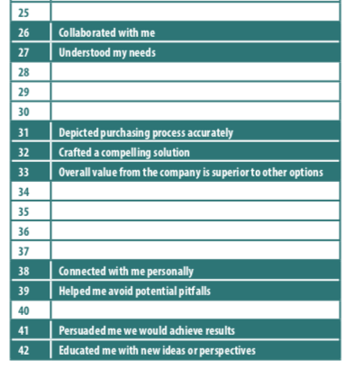
Get the whitepaper:
https://info.rainsalestraining.com/free-report-what-sales-winners-do-differently

Slide 21
Take away three things:
Educate with new ideas or perspectives
Collaborate with me
Persuade me how we will get results
Or you most likely won’t get the key sale.

Slide 23
As we all know, clients and key accounts need to be cultivated. I always ask myself, how am I going to sound different from everyone else and how am I going to bring value…
I do this by following the market and several other Business Journal’s, up and down California, both their print editions and their digital newsletters. A lot of news is spreading about the fires happening and PG&E shutting down large areas and leaving many homes and businesses without power. I reached out to both PG&E and AT&T.
After several attempts, I located AT&T’s agency and offered them a branding blitz to capitalize on the negative attention. I know agencies always want to look glorified to their clients by showing them the “great deal” they were able to negotiate on their clients behalf.
I inflated their rate and showed them a “discounted rate” on advertising in our market. I also showed them how many people in the area they would be impacting by advertising to justify the additional spend. Not to mention, I guaranteed them a premium position as added value.
A few weeks later, I received a buy for $63,000 for Q4. This was client we hadn’t had since 2008.
-Kaysi Curtin, Sales and Marketing Manager

Slide 24
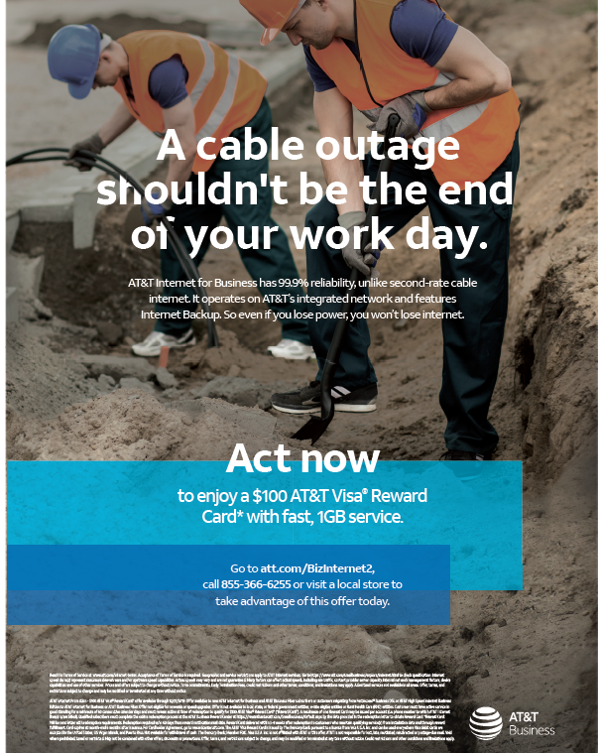

Slide 25
Twin Cities

Slide 47
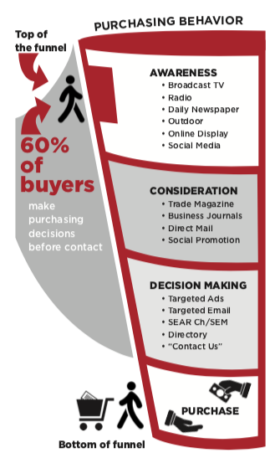

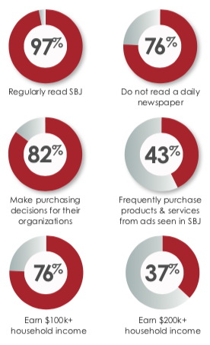

Slide 48
Creative Strategy for Pinegar Chevrolet
Objective: Develop highly effective messaging that impacts Springfield Business Journal’s affluent, local audience while they are in the consideration phase with the intention to influence their purchasing decision as they enter the market to buy a vehicle.
Why SBJ Readers are a good choice:
59% of readers are local males age 35+. This is an elusive audience… 75% of SBJ subscribers do not read a newspaper.
SBJ readers have purchasing power: 70% have household income over $100k and 23% have household income over $200k.
SBJ readers are decision makers at their companies: 86% are in decision making roles. 70% are owners, presidents, GM’s or other key level.
Creative Strategy: Separate Pinegar from local competition by focusing on local ownership, history in SW Missouri, Pinegar’s family history as well as competitive service, pricing and selection.
Why this Strategy will resonate with SBJ readers:
That’s the story of SBJ readers… locally-owned, family-oriented businesses doing business in the community they love.
SBJ readers enjoy reading stories and coverage of other business owners they know and trust.
SBJ readers appreciate loyalty because they do business right here in the Ozarks.

Slide 49
Central Theme
Creative Focus
Outcome
Team
Customers
Community
Pinegar Roots
Family
Loyalty
Value
Retention
New Acquisition

Slide 50
Creative Strategy for Pinegar Chevrolet
Creative Execution: Position Full Page Ads adjacent to all “A Conversation with…” editorial features. This offers an exclusive anchored position in SBJ that allows a frequent message for maximum impact.
Develop creative campaigns for TEAM, CUSTOMERS, COMMUNITY and PINEGAR ROOTS. The concepts for each category will support the greater mission to promote Family, Loyalty and Value.

Slide 51


Picture This…
SBJ develops a Polaroid-like theme that tells the Pinegar story from then until now by focusing on:
Team – images of smiling employees from various departments localizing the family spirit within the Pinegar dealerships.
Customers – show fun pictures of proud local buyers with new keys in hand
Community – demonstrate community involvement with key projects, volunteerism and service by Pinegar family and employees
Pinegar Roots – share family pictures that connect readers with the Pinegar generations in our community.
“The white frame of a Polaroid photograph is deeply embedded within our cultural consciousness. For young hipsters, it represents something retro and cool - the Instagram of the analogue age - while for those old enough to remember the original Polaroid camera it remains an iconic symbol of the democratisation of photography.”
- The Internet

Slide 52


Slide 53


2019 Finance Competitive Report

Slide 54


























BANKING & FINANCE CATEGORY 2019

Slide 55
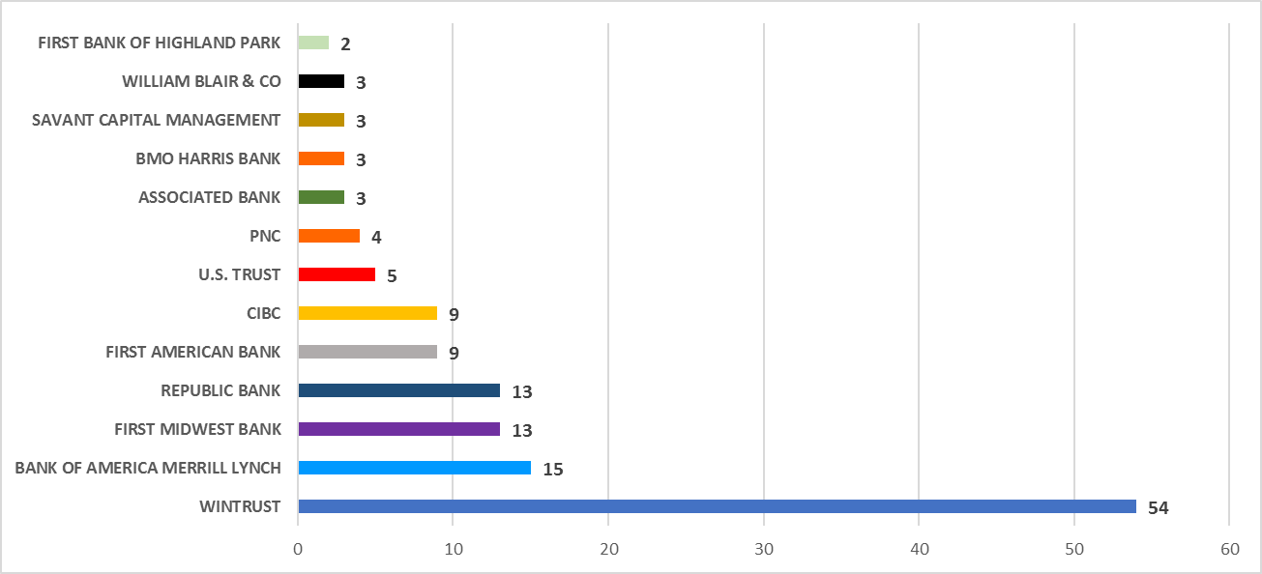
2019 PRINT AD FREQUENCY: BANKING & FINANCE

Slide 56
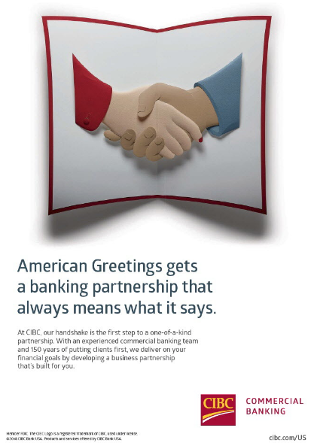
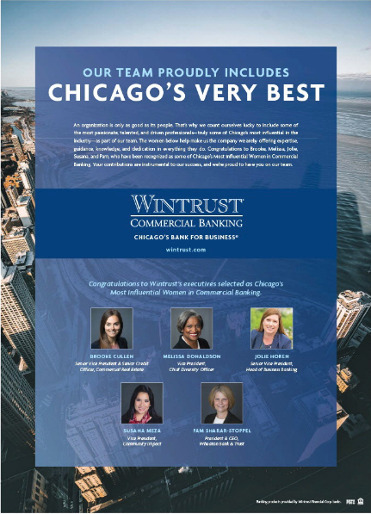
2019 PRINT ADVERTISING: BANKING & FINANCE
Altair Advisers LLC
Captive Resources
Certus Financial
Chicago Capital, LLC
Chicago Equity Partners
Discover Financial Services
Federal Home Loan Bank of Chicago
Fifth Third Bank
GTCR
Guaranteed Rate
Strategic Retirement Partners
US Bank
One time advertisers

Slide 57
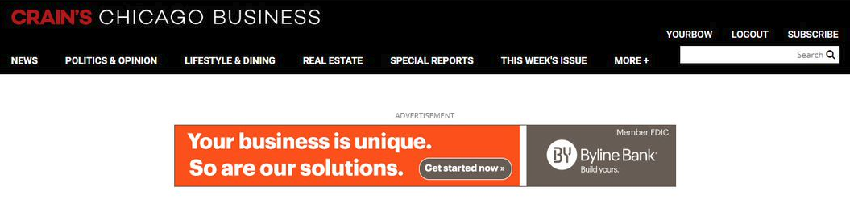
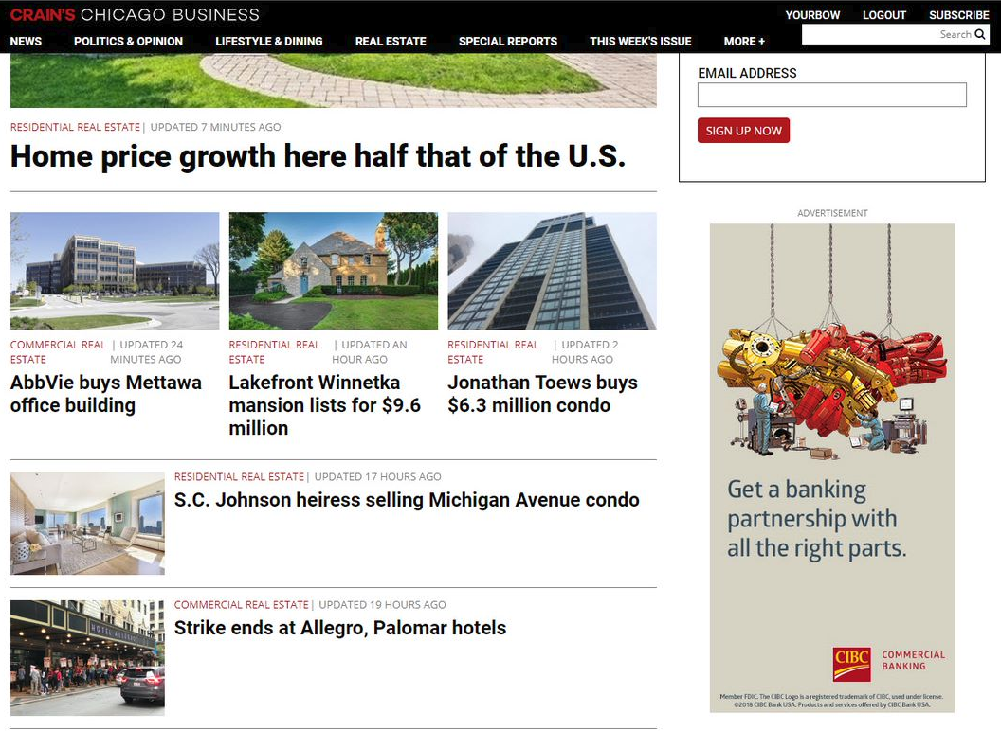
2019 DIGITAL ADVERTISING: BANKING & FINANCE

Slide 58
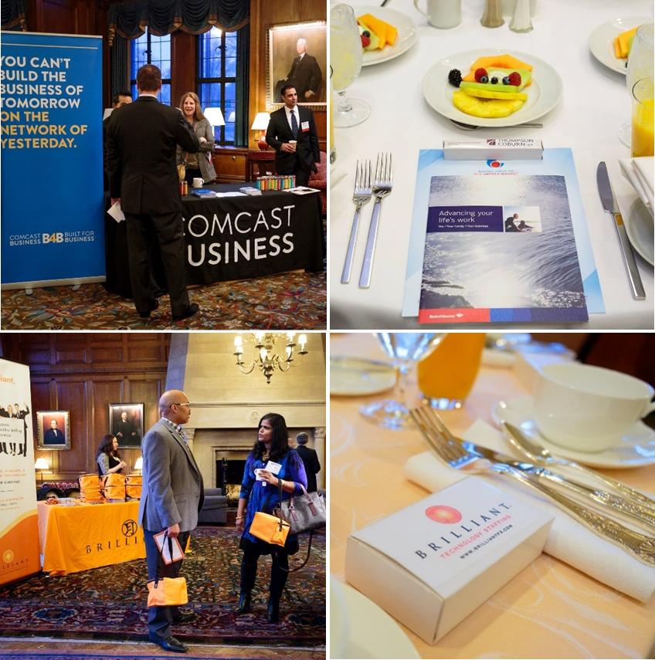
2019 EVENT ADVERTISING: BANKING & FINANCE

Slide 59
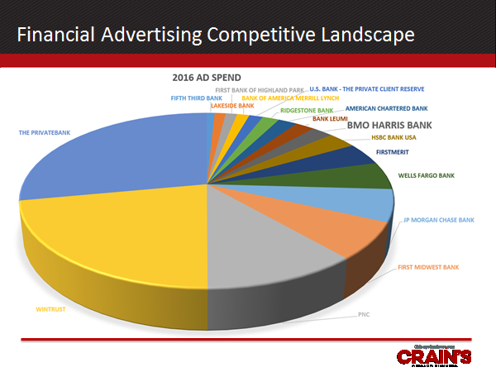

Slide 60
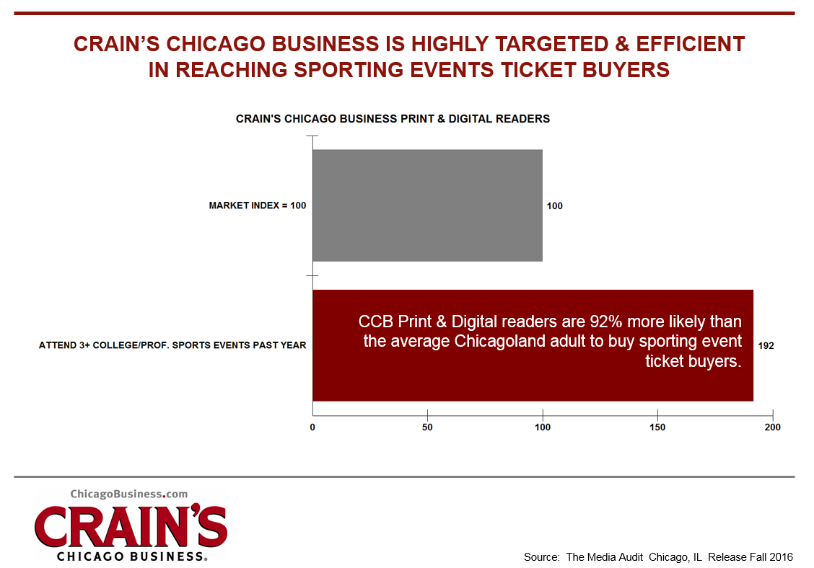
RESEARCH: CRAIN’S CHICAGO BUSINESS- MEDIA AUDIT

Slide 61
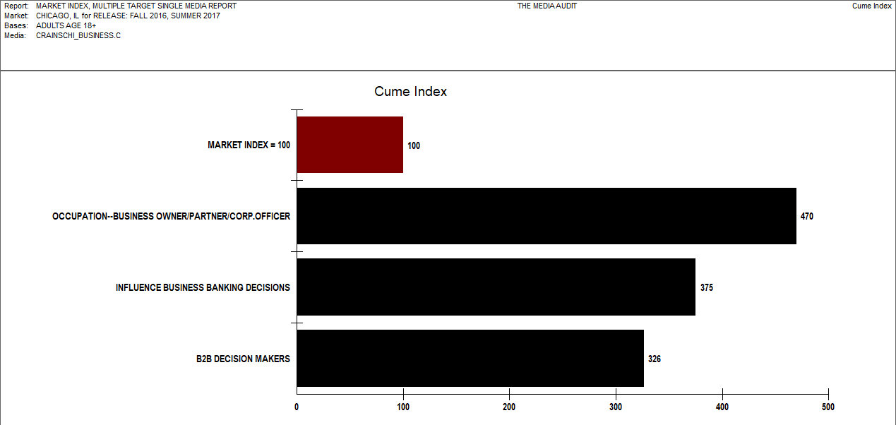
CrainsChicagoBusiness.com Is Effective Delivering
Business Owners/Partners/Corporate Officers

Slide 62
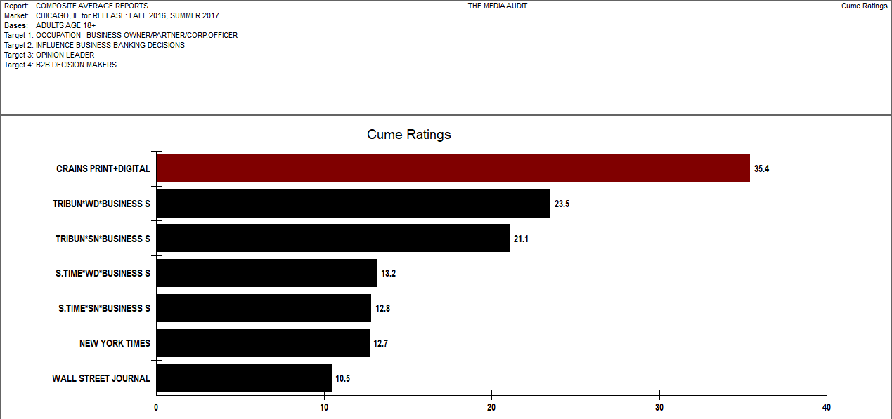
Crain’s Chicago & ChicagoBusiness.com Reach More
Business Owners/Partners/Corporate Officers

Slide 63
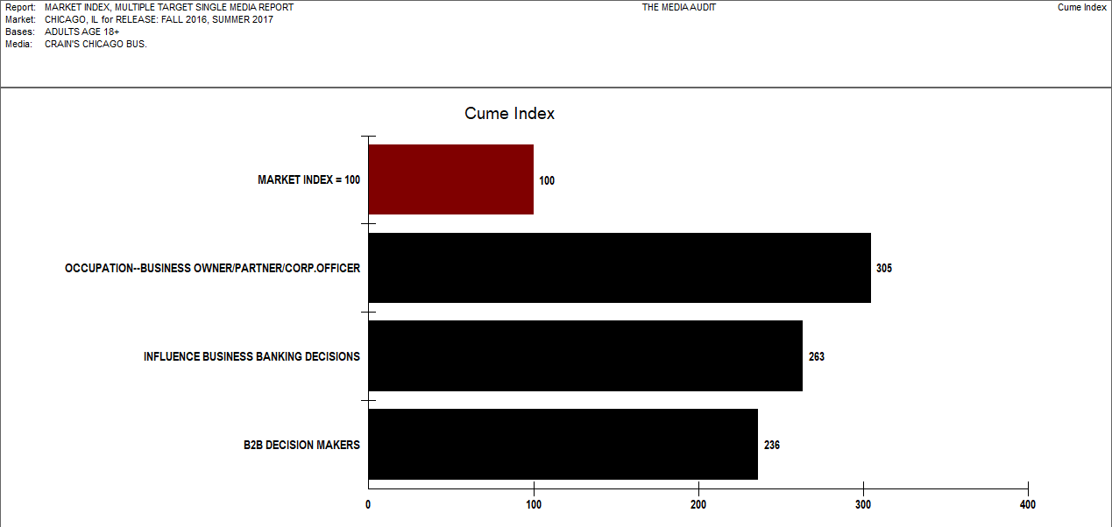
Crain’s Chicago Is Very Targeted, Efficiently Delivering
Business Owners/Partners/Corporate Officers

Slide 64
Q&A

